Slide 1








UDYAMINI
YOUNG MINDS MAKE THE DIFFERENCE

Slide 2



MEET OUR TEAM
Subhadeep Kundu
Sanjoy Dey
Mainak Sarkar

Slide 3
WHAT IS UDYAMINI?
The UDYAMINI app is a comprehensive platform designed to promote women’s empowerment, education, sex education for free.

Slide 4

WHY SHALL I DOWNLOAD UDYAMINI?
Download link: https://drive.google.com/file/d/16eup3dD9wFNAJxzmtxbAVhTfFwNW2X1y/view?usp=drive_link

Slide 5
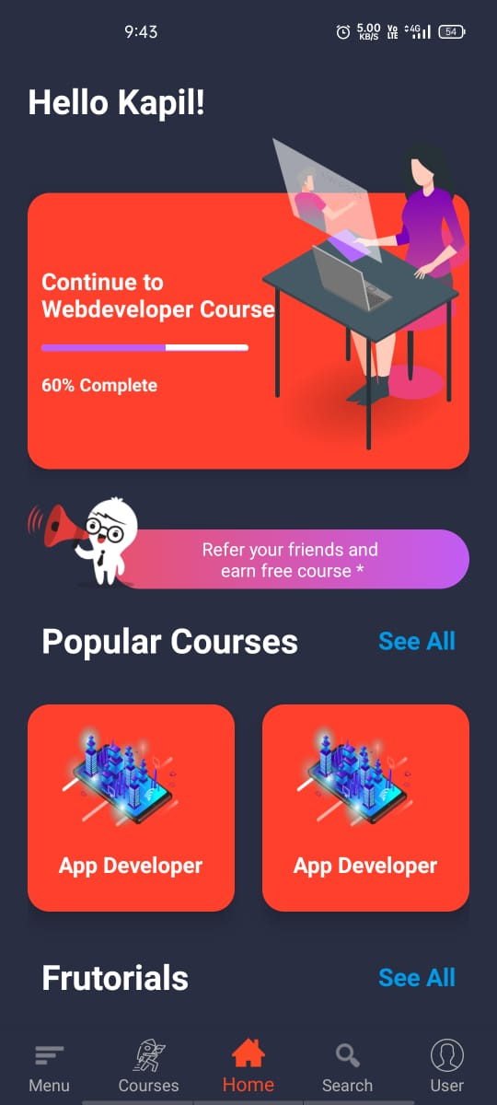
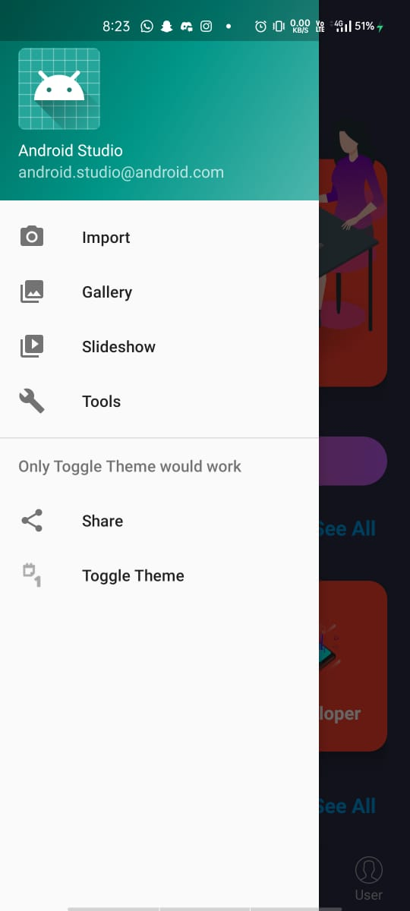
FEATURES
USER AUTHENTICATION
EDUCATIONAL CONTENT
COMMUNITY SUPPORT
SECURE AND PRIVATE

Slide 6
CONTENT AND MODULES
EDUCATION : E-learning Courses available in offline mode.
BUT
OUR MAIN FOCUS?

Slide 7
WOMEN EMPOWERMENT AND SEX EDUCATION IN RURAL AREAS
62% of women received no schooling at all, compared to 31% of men. In addition, women had worse late- life cognition. The disparity in cognition between men and women was more pronounced at lower levels of education and for the oldest adults in the sample.

Slide 8
“ 1 out of every 6 women has been the victim of an attempted or completed
RAPE
in her lifetime. “

Slide 9
SCALABILITY
Promotes offline education 24/7
Promotes Women empowerment and Sex education as the main concern
Education now made easier with the e-learning process.

Slide 10
SUPPORT
Any arising queries or assistance required regarding the Udyamini application, Reach out our support team at
Email- support@abcd.com
Phone- +91 1234567891
Website- https://www.abcd.com/support
That’s it for now towards the UDYAMINI app. We’re looking forward to add more contents and User Interface feasibility for more enhanced performance of the application.
We hope it serves as a valuable resource in promoting women’s empowerment and providing comprehensive sex education.

Slide 11
THANK YOU

